Slide 1


TECHNOLOGICAL UNIVERSITY DUBLIN
SCHOOL OF ELECTRIC AND ELECTRONIC ENGINEERING
Viva Voce Examination:
Building Integration of a Solar Air Heating System
PhD Student: Fernando Superbi Guerreiro
Supervisors: Prof. Brian Norton
Prof. David Kennedy
Dr. Michael McKeever

Slide 2
Context
Demand for renewable energy – Solar energy (zero carbon emission)
Solar air heating systems: low-medium temperature (30 – 90 ºC)
Building integrated systems to be installed on a façade wall
A system of building integrated solar collectors can provide hot air so fossil fuel consumption can be offset

Slide 3
Main Goal and Objectives
Design and characterise a building integrated air heating system capable of receiving 8 hours of solar radiation per day to heat air flow in the summer.
Develop a mathematical model to build the collector’s shape and evaluate its optical performance with 3D ray tracing to decide the design;
Undertake field tests for the collector’s thermal characterisation to achieve a well understanding of the variables that affect its performance;
Simulate the collector’s thermal behaviour from a transient heat transfer modelling, validate it using experimental data, and apply the validated model to simulate the performance for multiple collectors in series/parallel configurations;
Simulate a barley drying as an application for the solar collector system based on the energy demand.

Slide 4
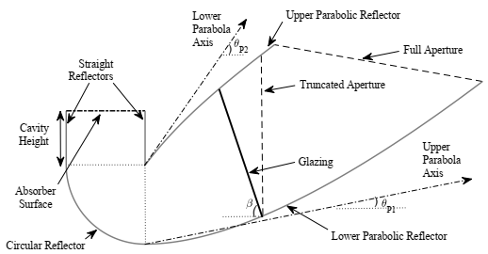
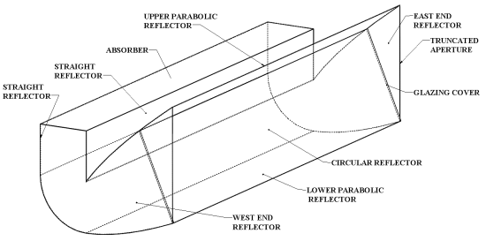
Optical Modelling and Design
Develop an optical model 3D ray tracing techniques implemented in Matlab;
Evaluate geometric properties of the concentrator to investigate optical performance;
Objectives
Characterise the optical profile of a concentrator used for experimental tests.
Concept: ACPC + inverted absorber
Asymmetry enables more solar energy collection at broader acceptance angles;
Inverted absorber reduces convective and radiative losses;
Vertical aperture maximises aperture size and avoid shading;

Slide 5
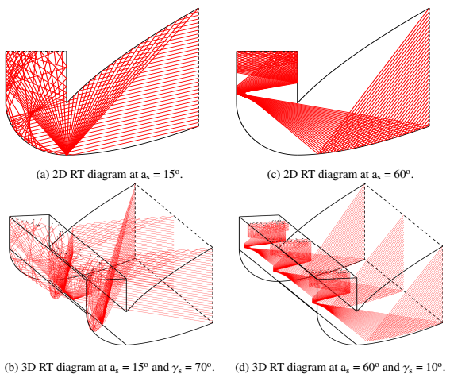
Ray Tracing and Optical Modelling
Algorithm to simulate the Sun’s position and sunlight rays passing through an optical system;
Requirements
Used to help the optical modelling and then help deciding the dimensions of the solar collector to be made.
Ray Tracing
Location: Dublin (latitude 53.35º and longitude -6.26º)
Output variable: optical efficiency.
It must operate 8h/day, from 9am to 5pm during the Irish summer

Slide 6
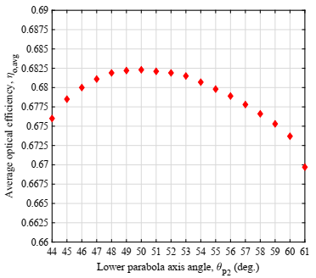
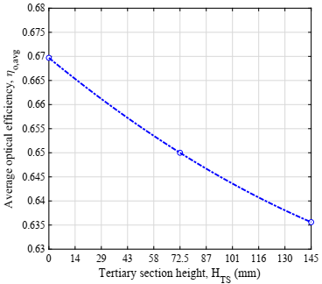
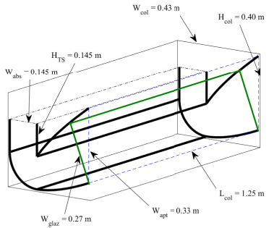
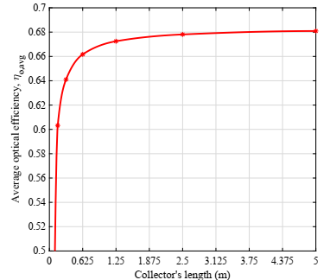
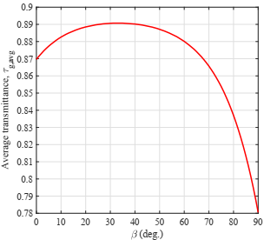
Optical Results
Effect of parabolic shape
Effect of tertiary section
Proposed collector: CR = 2.28
Effect of the ends
Effect of glazing inclination

Slide 7
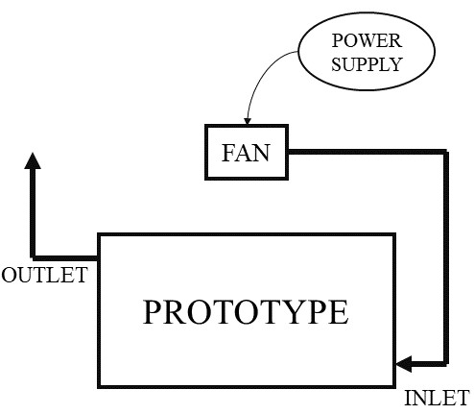
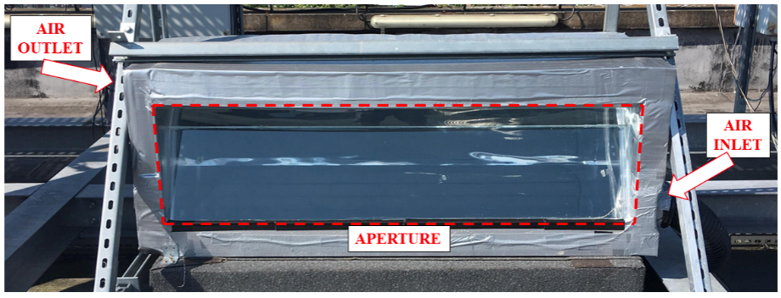
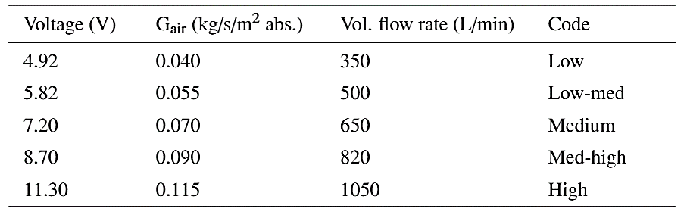
Experimental Performance
Present the materials and components for fabrication;
Describe the data collection procedure and equipment used;
Objectives
Evaluate the thermal performance of the system in open loop configuration.
Airflow levels

Slide 8
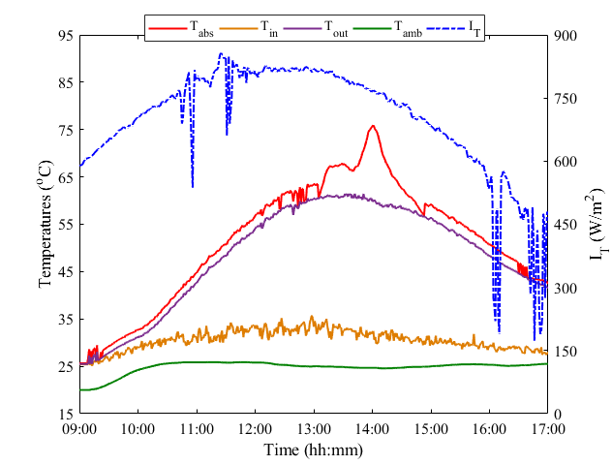
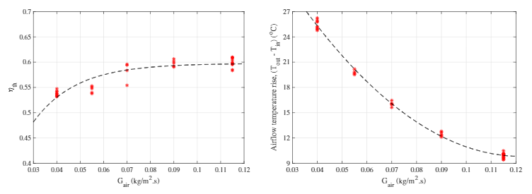
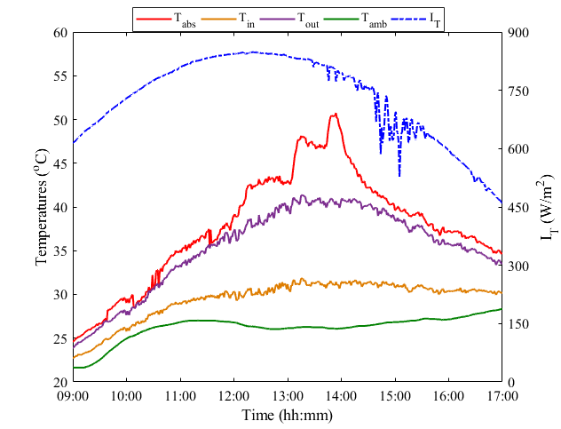
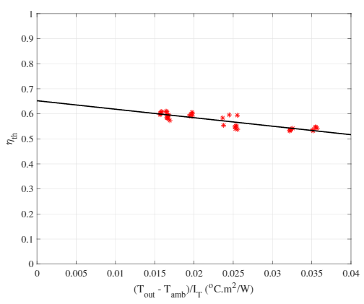
Experimental Results
Day operation:
Nearly Steady State:

Slide 9
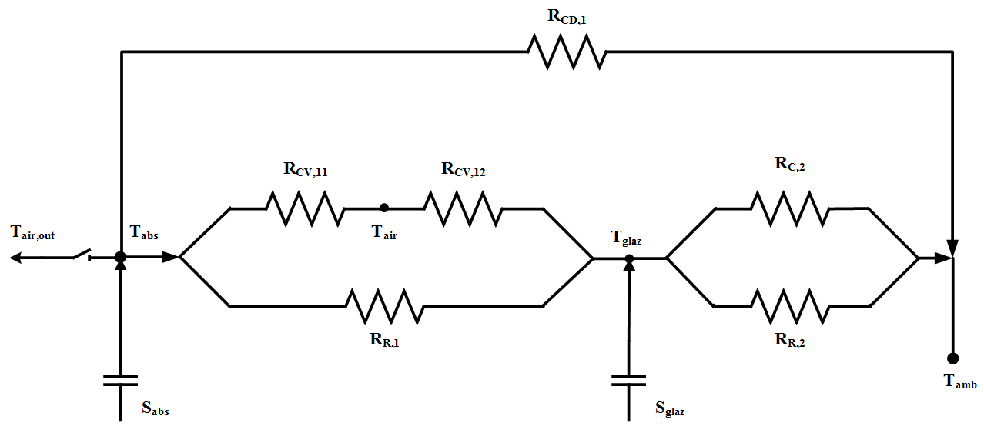
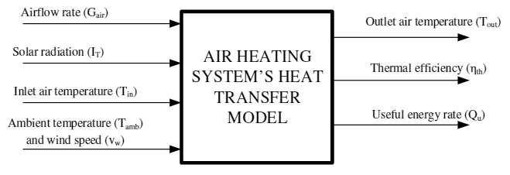
Heat Transfer Modelling
Develop a heat transfer model to characterise and simulate the thermal performance of the proposed solar air heater in operation;
Validate the model against experimental data from the tests;
Objectives
Simulate multiple units connected;
Simulate an application for the heated air.

Slide 10
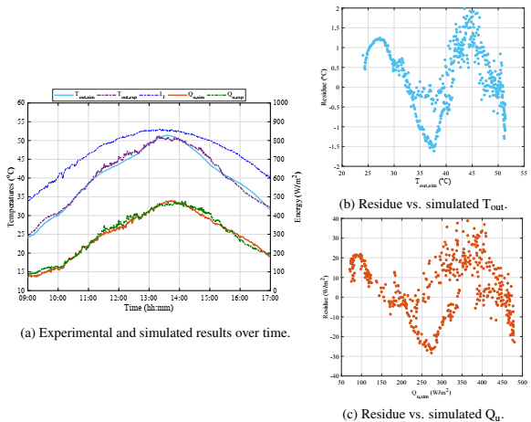
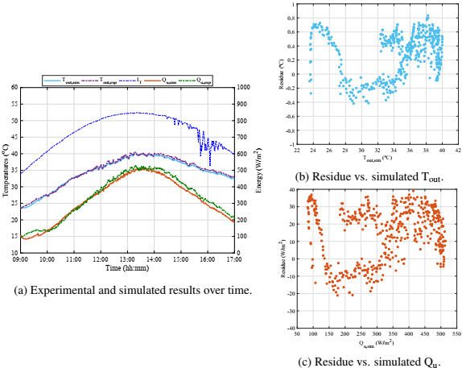
Model Validation

Slide 11
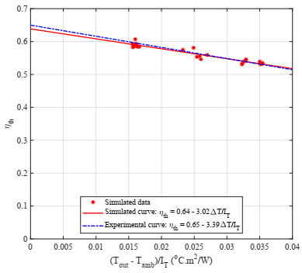
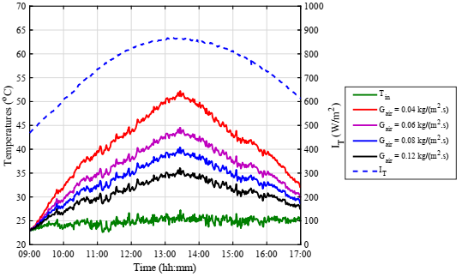
Thermal Characterisation
Input ranges:
Solar radiation: 500 – 1000 W/m²;
Mass airflow rate: 0.04 – 0.12 kg/(m².s);
Ambient and inlet air temperature: 20 – 30 ºC;
Wind speed: 0 – 10 m/s.
Shams, 2013:
Experimental IACPC: CR = 2 and H_{TS}/W_{abs} = 0.5
η_{th} = 0.73 – 3.25ΔT/I_{T}

Slide 12
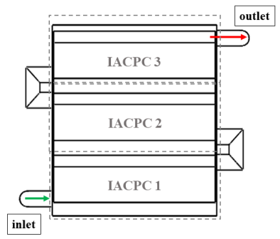
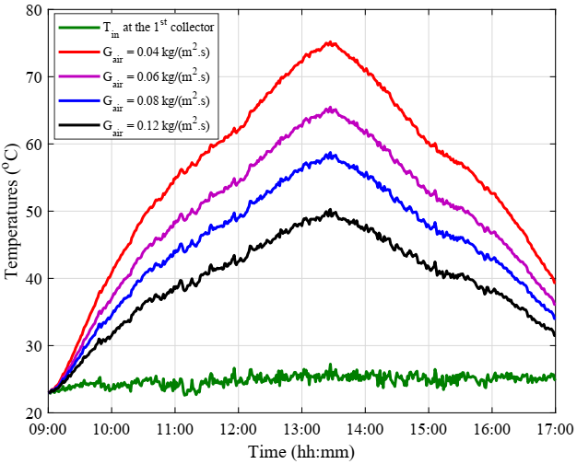
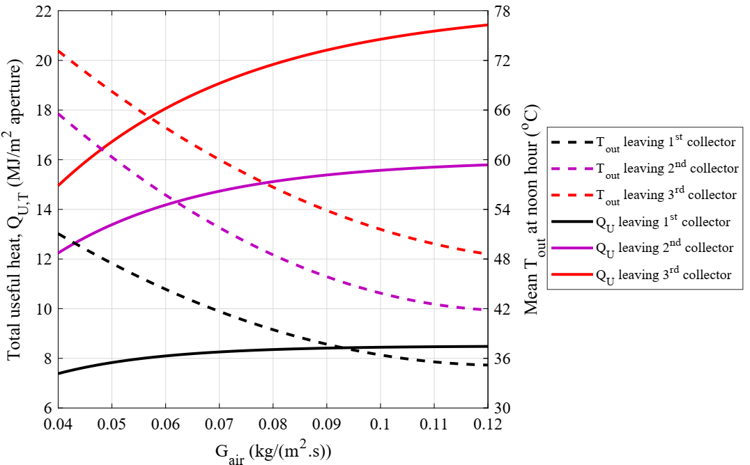
Thermal Simulation of 3 Collectors Connected
Connection in series

Slide 13
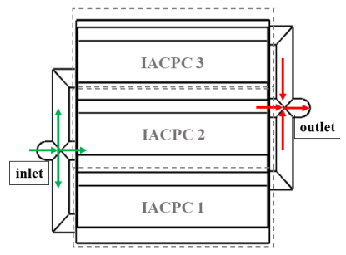
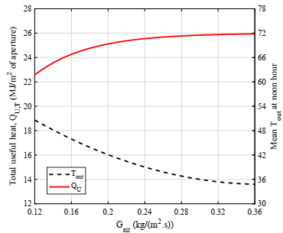
Thermal Simulation of 3 Collectors Connected
Connection in parallel

Slide 14
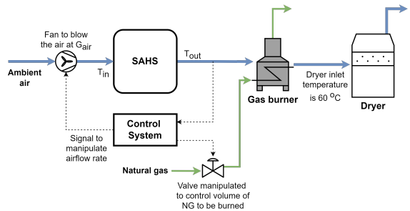
Barley Drying Simulation
Drying is an operation to evaporate moisture from grains to preserve quality, prevent bacteria, fungi, and pests, and produce higher-quality products for consumption or sale;
Heated air is employed to dry, being the most common means of heat transfer;
Introduction and requirements
To dry barley for malting, it is advised to maintain the maximum temperature in the grains at 45 ºC;
Initial moisture content of barley is 20% to be dried until it reaches 15%;
The source of heating is obtained by burning natural gas whose calorific value is 40 MJ/m³;
The airflow temperature set to dry barley is 60 ºC.

Slide 15
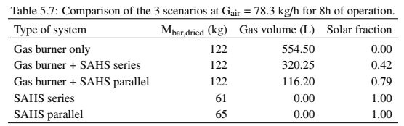
Barley Drying Simulation
Scenario 1: Air heating by gas burner alone
Scenario 2: Air heating using gas burner and solar system
Scenario 3: Air heating using solar system alone

Slide 16
Conclusions
A 3D ray tracing analysis was developed to optimize collector design, revealing peak optical efficiency at specific reflector shapes and glazing transmittances, with the proposed concentrator absorbing 67% of direct solar radiation on average.
Experiments characterized the collector in open-loop, with airflow varied by a 12-W fan; results showed maximum outlet temperatures from 40°C to 52°C and thermal efficiency from 52% to 62%.
Thermal modelling of the solar air concentrator, validated against experimental data, showed a 2% mean absolute error in temperature and 8% in useful energy, with 95% of errors within ±2°C and ±50 W/m². The model's thermal efficiency curve closely matched experimental results, with only 2% and 10% differences in Hottel-Whillier-Bliss parameters.
Thermal modelling predicted that three collectors connected in series yield higher outlet temperatures, while a parallel setup captures more heat but maintains the same outlet temperature as the first collector in series.
The thermal model was used to simulate barley drying in three scenarios: gas burner alone, solar plus gas burner, and solar alone. The gas burner alone had the highest gas use with zero solar fraction, while the solar-only setup produced less dried mass but achieved a solar fraction of 1, relying entirely on solar energy.

Slide 17
New Knowledge to the Research Area
Development of an accurate model capable of building the shape of CPCs, ACPCs and coupled with inverted absorbers. It considers design parameters, such as parabolic shape, concentration ratio, truncation, length, inclination and absorber position;
Coupling of this model to a 3D ray tracing technique that simulates direct solar radiation using solar angles (azimuth and altitude) from the Sun’s position;
Additional results obtained from an optical modelling in 3D when compared to the modelling in 2D, such as end losses and energy distribution along the absorber area;
Thermal modelling and simulation of more than one collector connected in series and in parallel to deliver higher airflow temperatures or more useful energy rate;
Use of the thermal modelling to simulate barley drying application to find how much energy can be replaced by the solar air heating system.

Slide 18
Remaining Work
Thesis writing
Literature review: Topics in building integration, thermal modelling and thermal modelling for other types of solar collectors will be included;
Computational Fluid Dynamics (CFD) modelling
Detailed understanding of the heat transfer within the concentrator. Simulations will be undertaken to investigate the effect of the tertiary section height;
Optical and design analysis for building integrated systems considering different shapes of concentrators and truncation levels.
Paper writing
Manuscript writing related to CFD modelling and simulation results.
Manuscript writing under the title ”Optical performance of building integrated asymmetric compound parabolic concentrators for air heating”;
The simulations will also consider the connection between collectors (series/parallel).

Slide 19
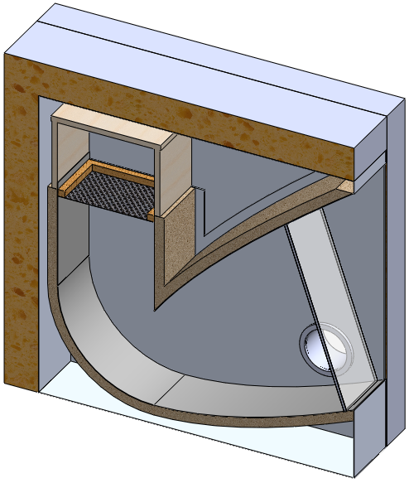
Experimental Set-up

Slide 20
Main Goal and Objectives

Slide 21
Optical Modelling and Design
Concept: Asymmetric Compound Parabolic Concentrator (ACPC) + Inverted Absorber
Asymmetry enables more solar energy collection at broader acceptance angles;
Inverted absorber reduces convective and radiative losses;
Vertical aperture maximises aperture size and avoid shading;
Glazing cover to protect against weather conditions;
The collector is oriented south-facing.

Slide 22
Significant new knowledge to the research area
2D vs. 3D Ray Tracing Modelling
CFD Analysis
Connection of Multiple Units
Effect of the tertiary section height
Optical and thermal modelling for stacked units
Effect of the end plates and the system’s length
Energy distribution over the absorber surface
Control System
Experimental test using two units
Performance prediction
Set-point of the outlet air temperature and manipulation of air flow
Set-point of the energy and manipulation of air flow

Slide 23
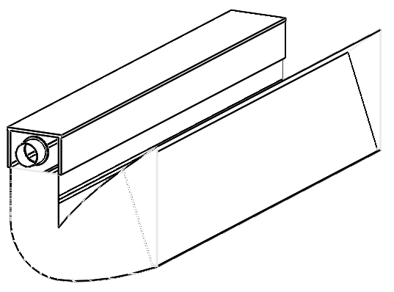
Introduction

Slide 24
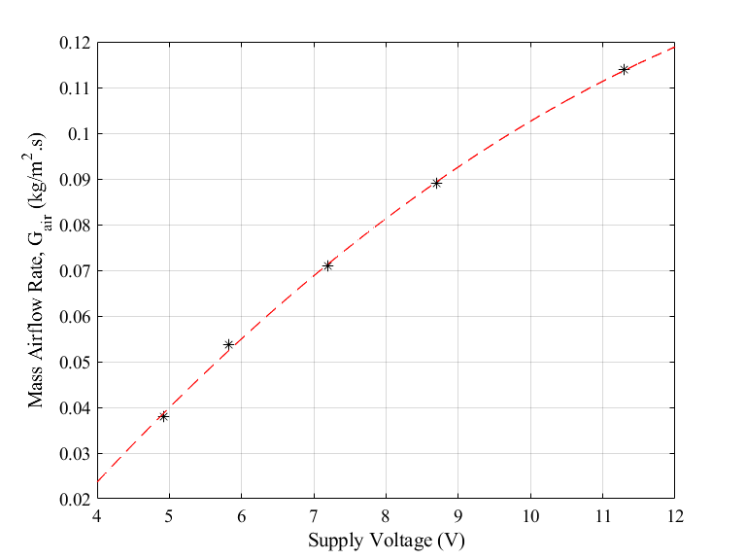
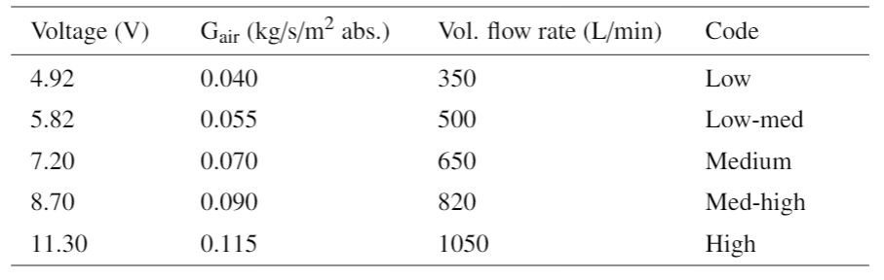
Experimental Tests
12 thermocouples at the absorber;
3 thermocouples at the glass outside;
1 thermocouple at the inlet;
1 thermocouple at the outlet;
10-W fan.

Slide 25
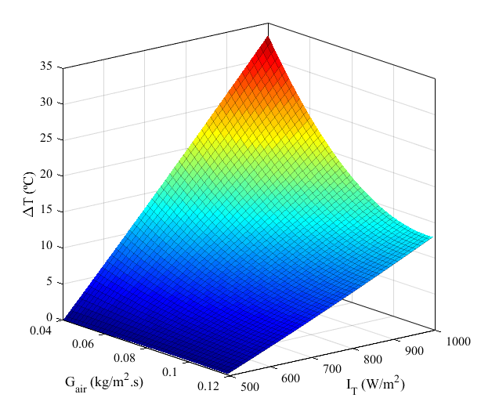
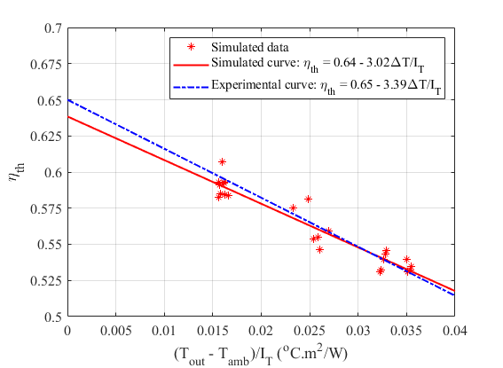
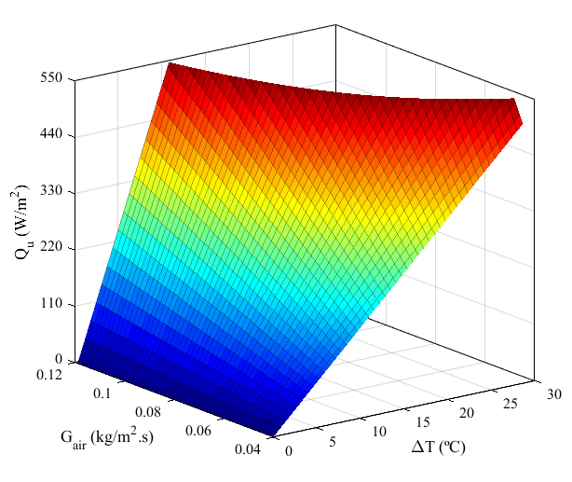
Thermal characterisation
Output ranges:
Air temperature rise: 0 – 32 ºC
Useful heat: 0 – 550 W/m²
Thermal efficiency: 0 – 62%
Shams, 2013:
Experimental IACPC: CR = 2 and H_{TS}/W_{abs} = 0.5
η_{th} = 0.73 – 3.25ΔT/I_{T}

Slide 26
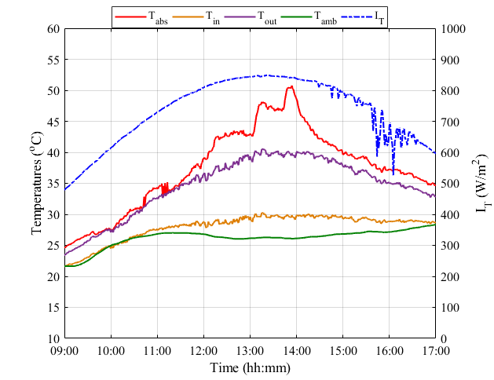
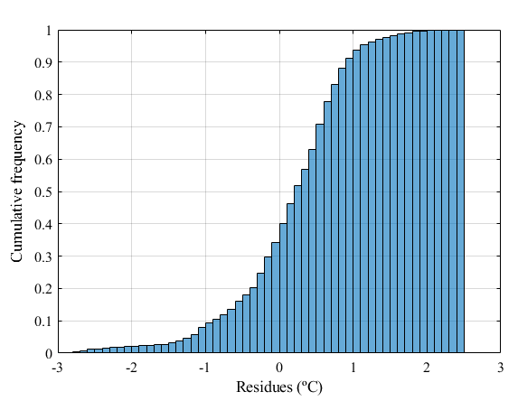
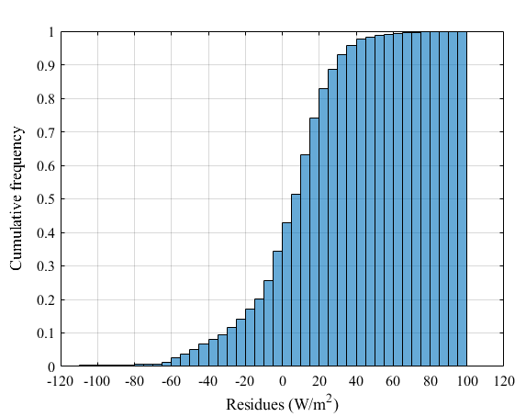
Heat transfer model validation
Cumulative frequency distribution:
95% of the data predicted have residues between ±2 ºC;
95% of the data predicted have residues between ±50 W/m².
65% of the predictions are underestimated, which highlights the underestimation of the simulation results at most of the time.
Experimental and simulated results of T_{out} and Q_{u} from 28th June at 0.115 kg/m².s.

Slide 27
Introduction
Drying of food/beverage products using low temperature;
Assembly of solar collectors to the application;
Save energy to heat air from the traditional way;
Temperature range: 30 – 90 ºC (IRENA, 2015)
Building Integration in order to collect more thermal energy and use higher flow rate;
Using collector as the main heater to offset electric energy partially.

Slide 28
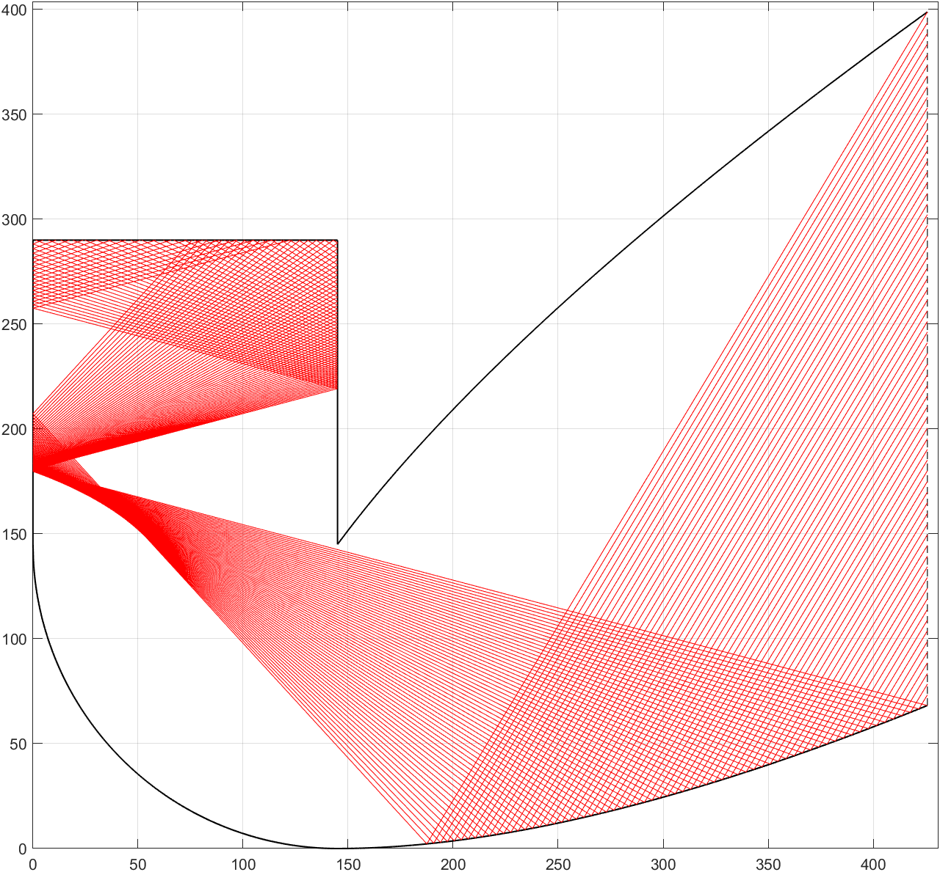
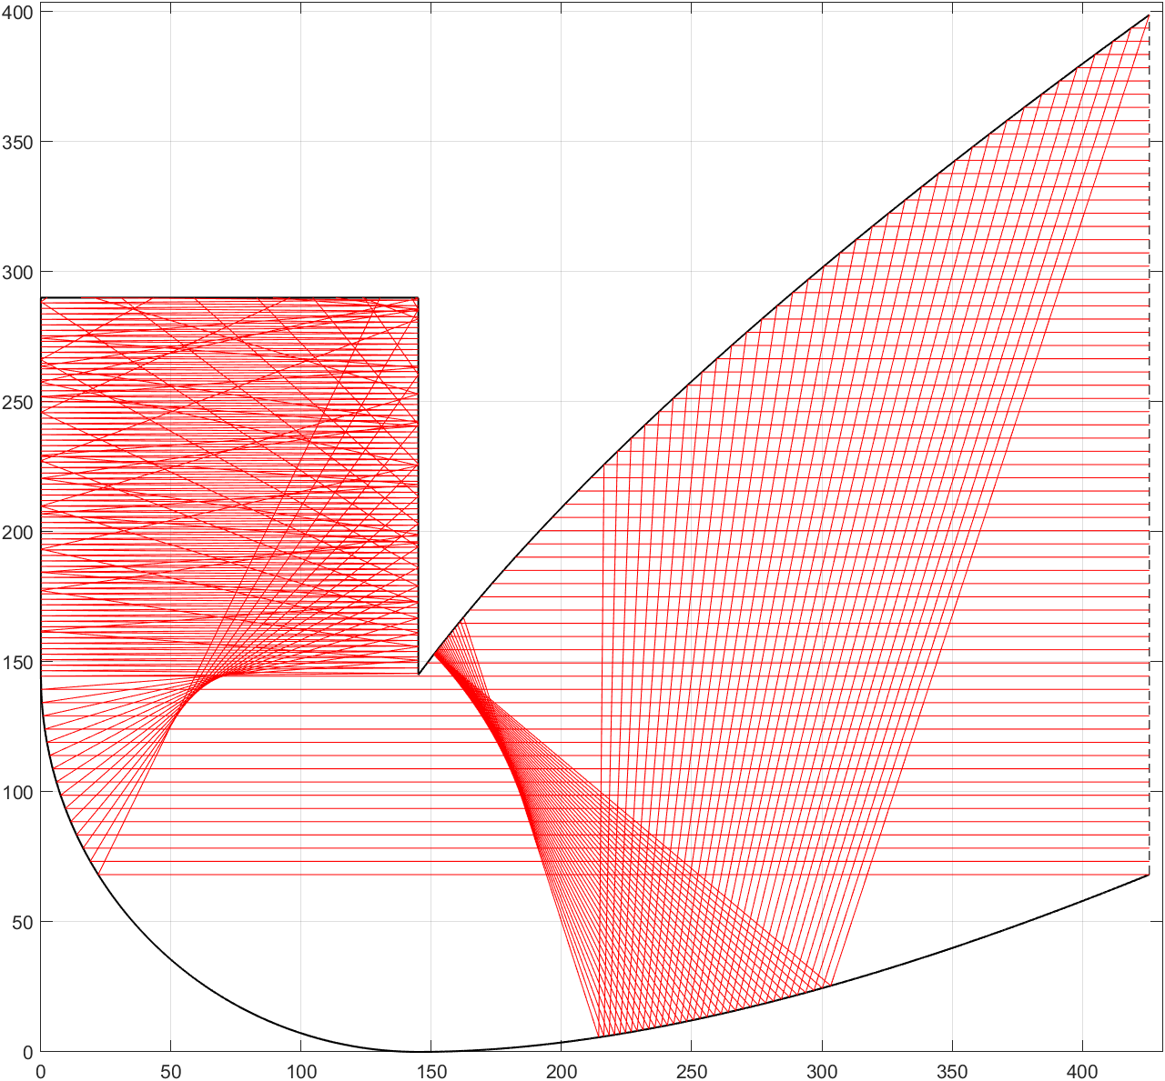
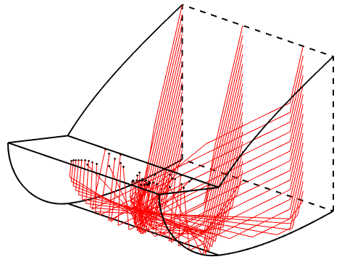
Ray Tracing and Optical Modelling
Ray tracing technique:
Algorithm to simulate sunlight rays passing through an optical system;
It was used to help the optical modelling and therefore help deciding the dimensions of the solar collector to be used.
Requirements:
Dublin, Ireland;
8h/day, 9am to 5pm;
21/06 – 21/09
Output variables:
Optical efficiency
Glazing transmittance

